Slide 1
Power BI Reports
Munish Arora
Power BI Reports
Design a Report
Enhance a Report

Slide 2
Power BI Reports
Design A Report
Enhance a Report
Line and Cluster Column Chart
Edit Interactions
Drill-through
Grouping And Binning
Bookmarks
Sync Slicers
Conditional Formatting

Slide 3

Lesson 1: Design a Report

Slide 4
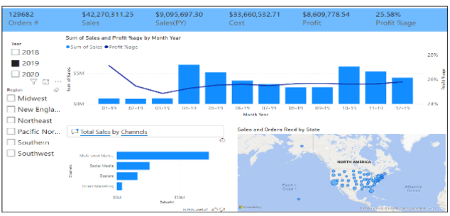
Introduction
Visuals allow you to share data insights more effectively.
Effective visualizations help your users connect and interact with the information

Slide 5
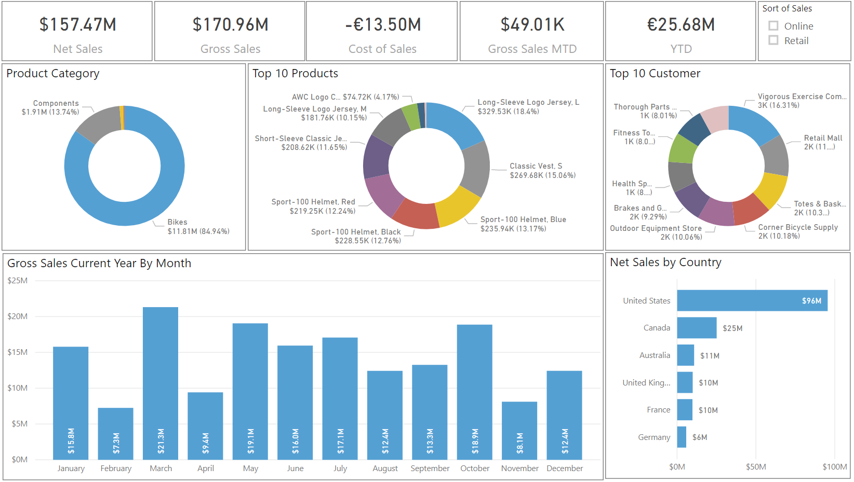
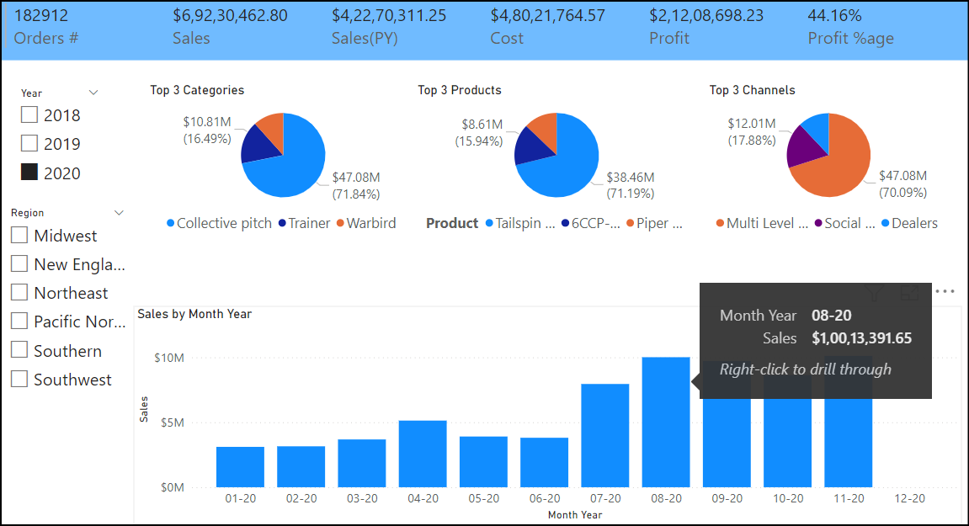
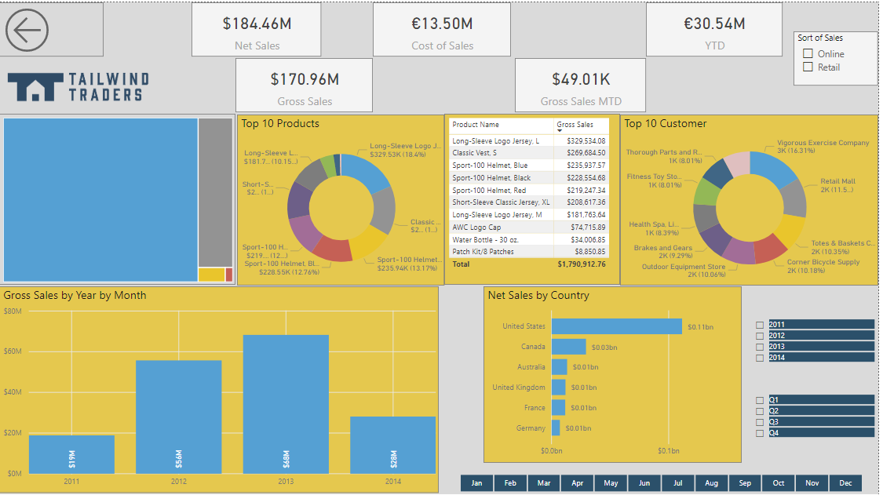
Design a Report Layout

Slide 6
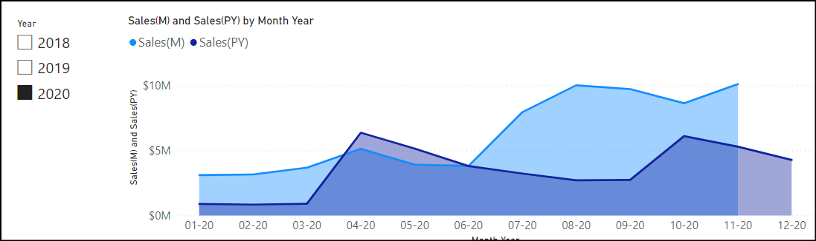
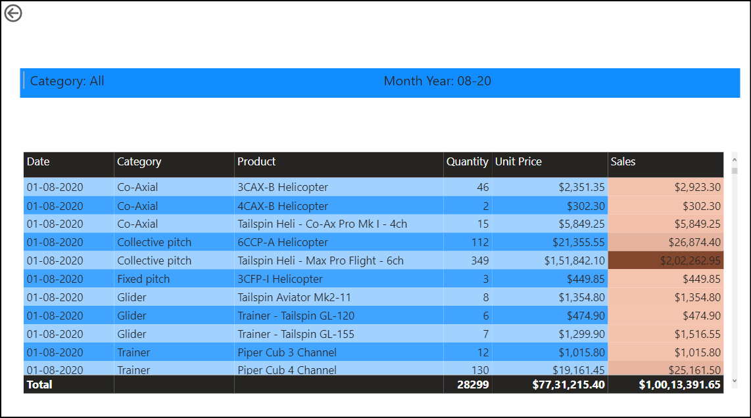
Choosing Effective Visualizations
Drillthrough

Slide 7
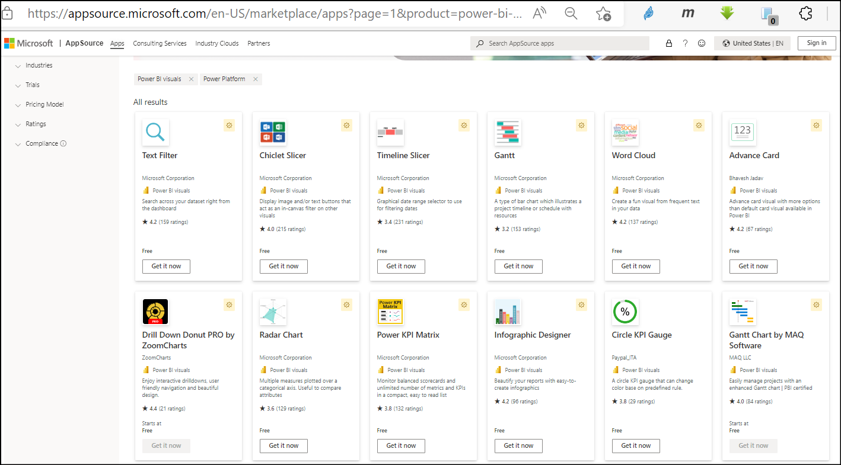
Custom Visuals
There is a built-in library of standard charts and visualizations in Power BI Desktop.
There are numerous visuals available at Business Apps – Microsoft AppSource.
Custom visuals is required to be imported each time you want to use it when you are developing a new report.

Slide 8
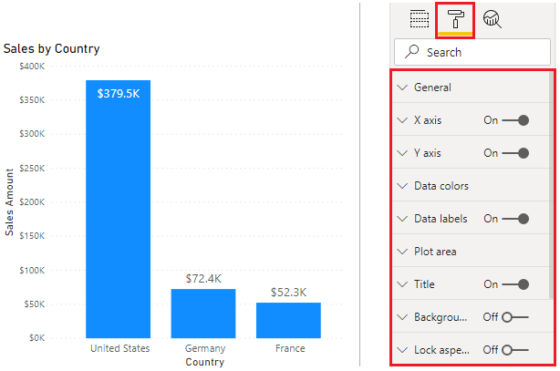
Format and Configure Visualizations
Control the look and feel of each visual.
Format options differ depending on the type of visual selected.

Slide 9
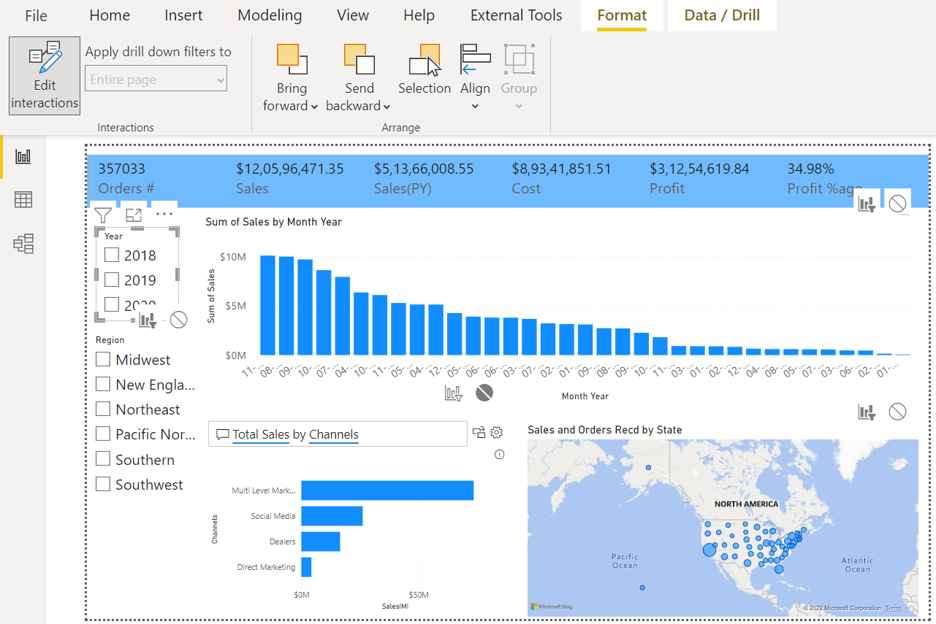
Basic Interactions
Power BI visuals are interacting with each other.
Selecting an item in a visual will effect on the display of another chart.
Sometimes this effect is highlighting items in another chart, and sometimes filtering values in the other visual.
Use interactions to change how visuals impact each other.

Slide 10
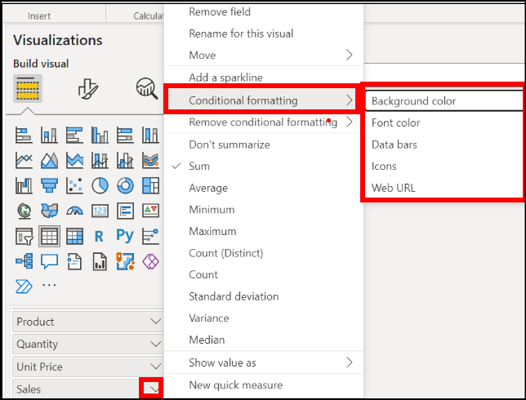
Conditional Formatting
With Conditional Formatting, we can
Specify customized cell colors, including color gradients, based on field values.
Represent cell values with data bars or KPI icons, or as active web links.

Slide 11
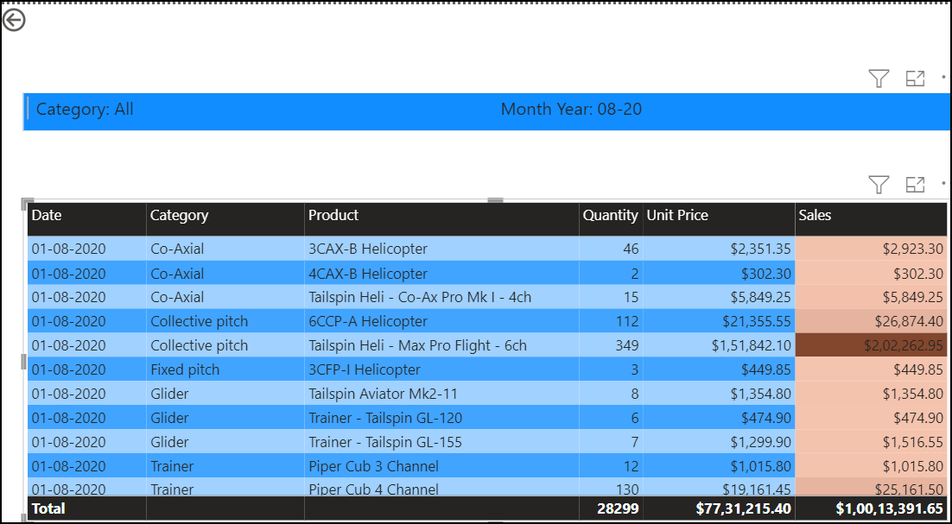
Design Report Navigation
Move users between pages.
Use buttons, bookmarks, or conditional formatting.

Slide 12
Knowledge Check
Q01 – What is the benefit of using a report tooltip?
It is a must
To provide additional detail that is specific to the context of the data that is being hovered over.
It is populated by default
A01 - B
Q02 –Do you need to import custom visuals each time you want to use them when you are developing a new report?
Yes
No
Varies based on type of custom visual
A02 – A, custom visuals need to be imported from AppSource each time you start developing a new report unless you pin the custom visual to the visualizations pane.

Slide 13
Lab 06: Design Report in Power BI Desktop
In this lab you learn how to:
Design a report
Configure visual fields and format properties

Slide 14
Lesson 2: Enhancing Report

Slide 15
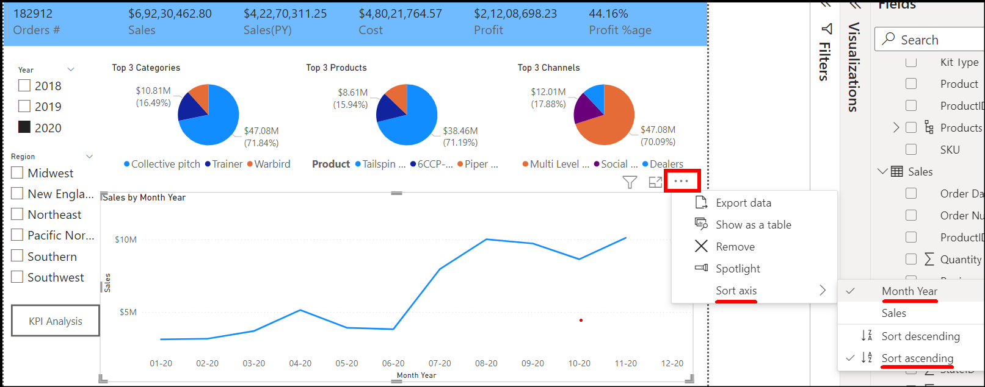
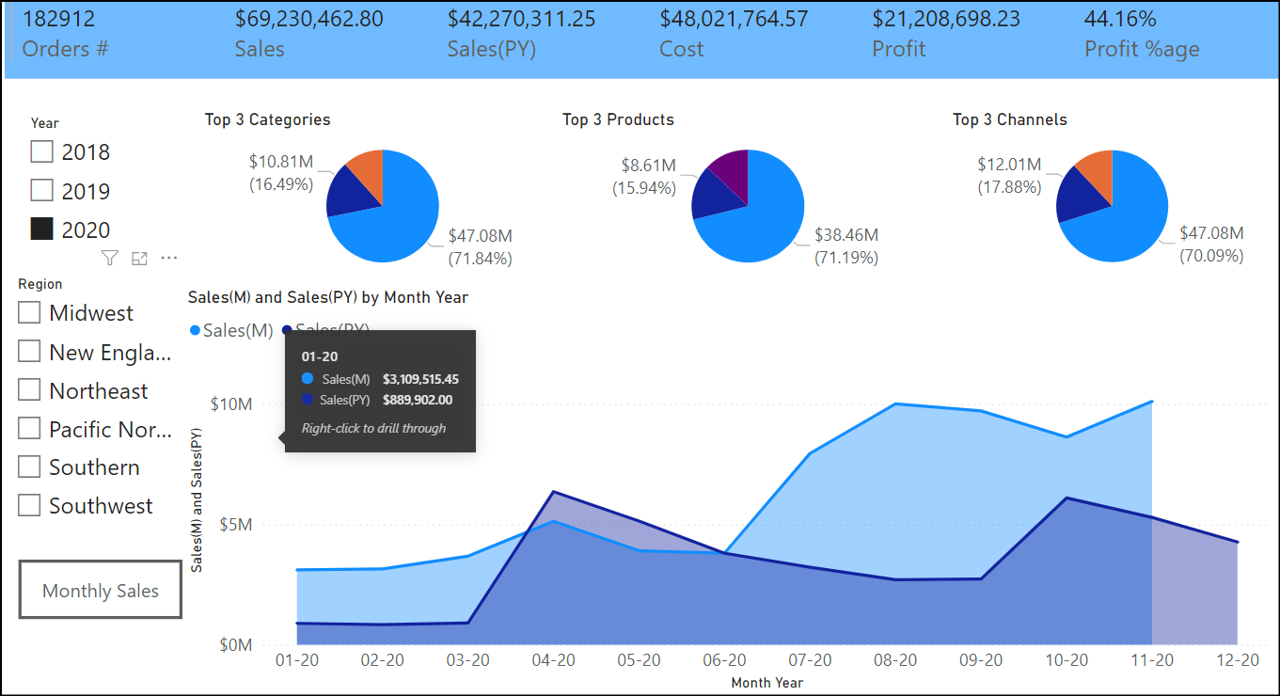
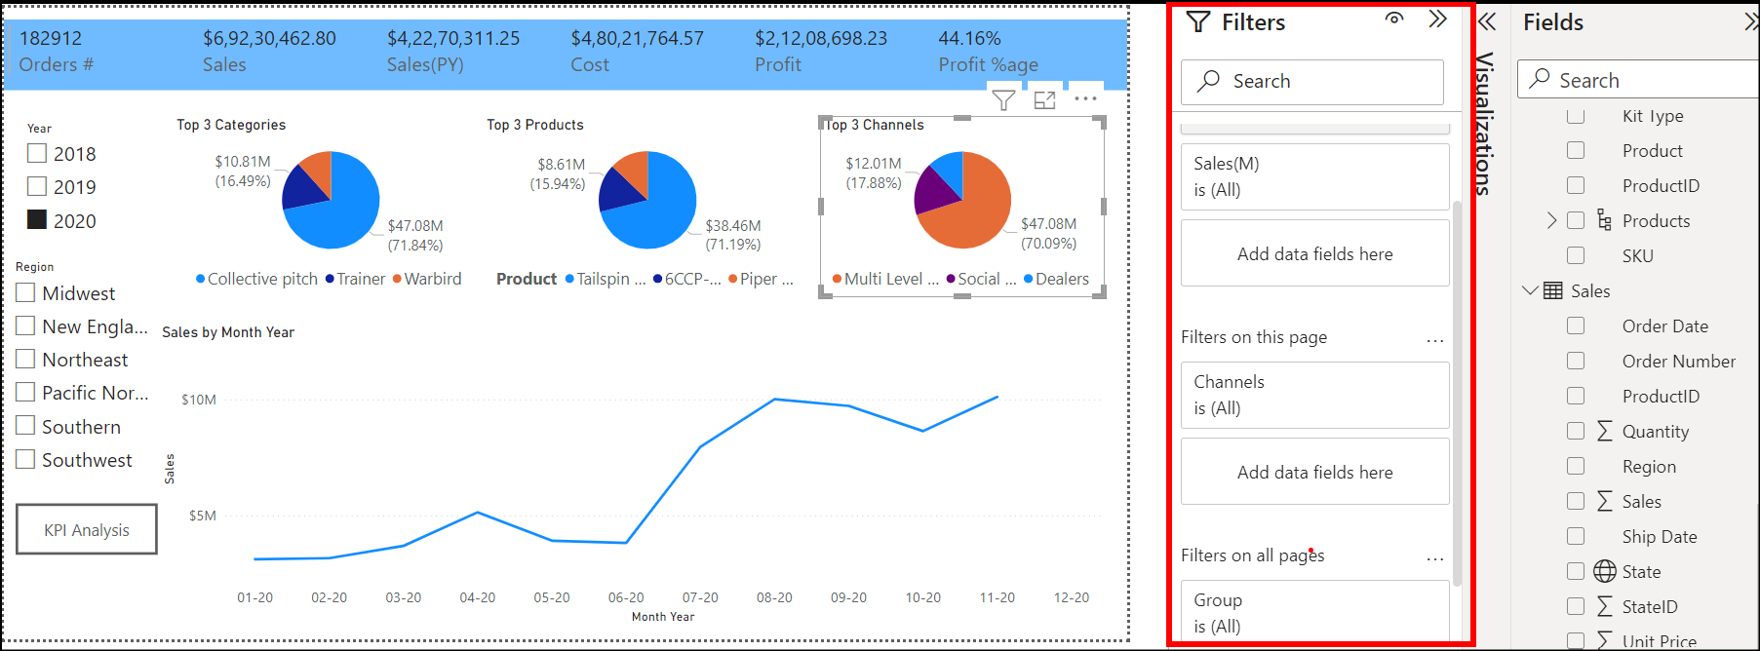
Apply Slicing, Filtering, and Sorting

Slide 16
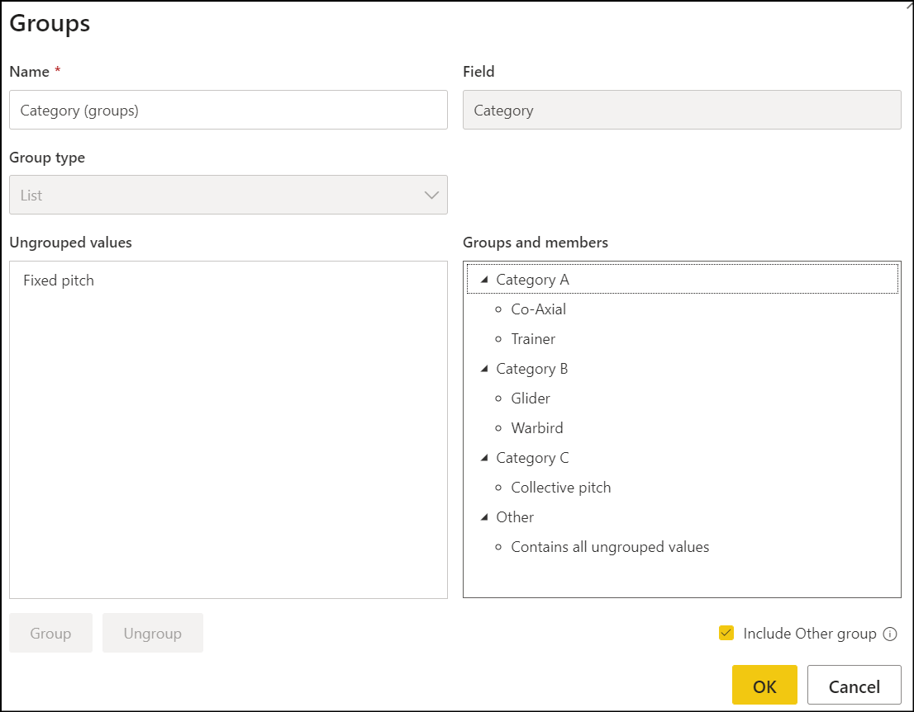
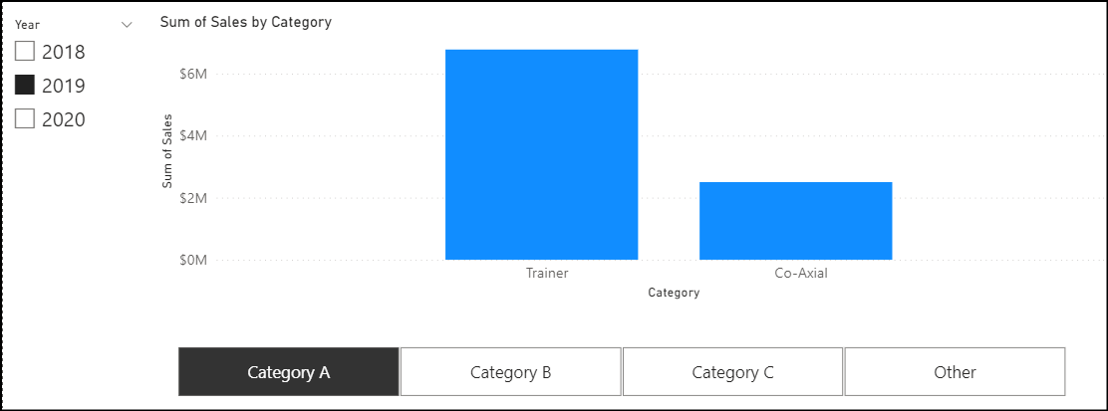
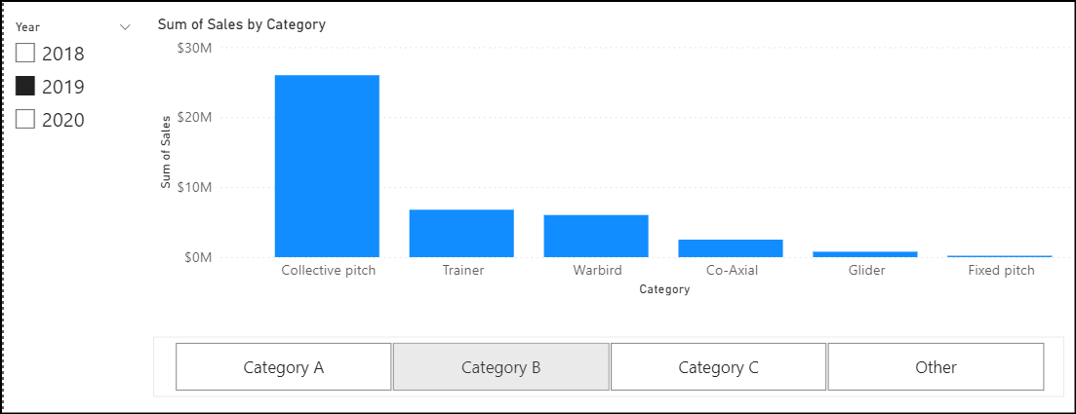
Grouping And Binning
Grouping: Group data points to help you more clearly view, analyze, and explore data and trends in your visuals.
Select ‘Category A’

Slide 17
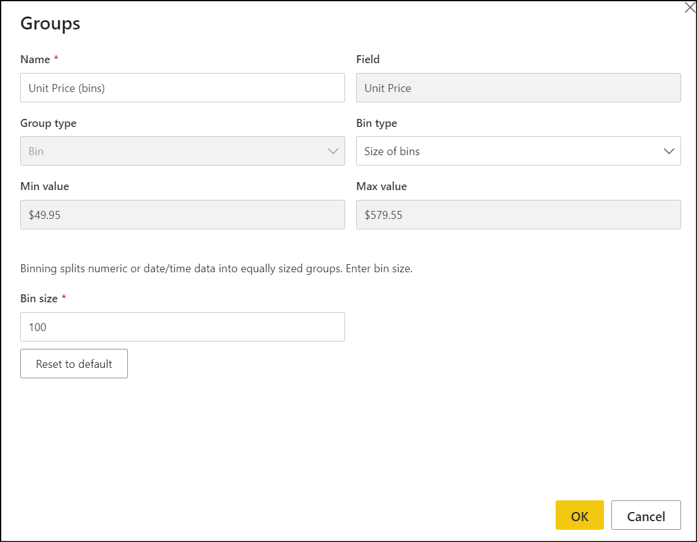
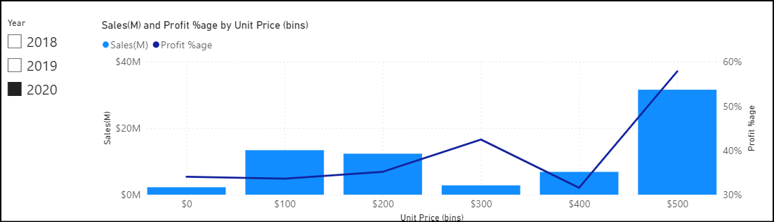
Grouping And Binning
Binning: Define the bin size to put values into equally sized groups that better enable you to visualize data in ways that are meaningful.
Define bin Size
We can do the analysis as to which bin is giving us more Sales /Profit %age

Slide 18
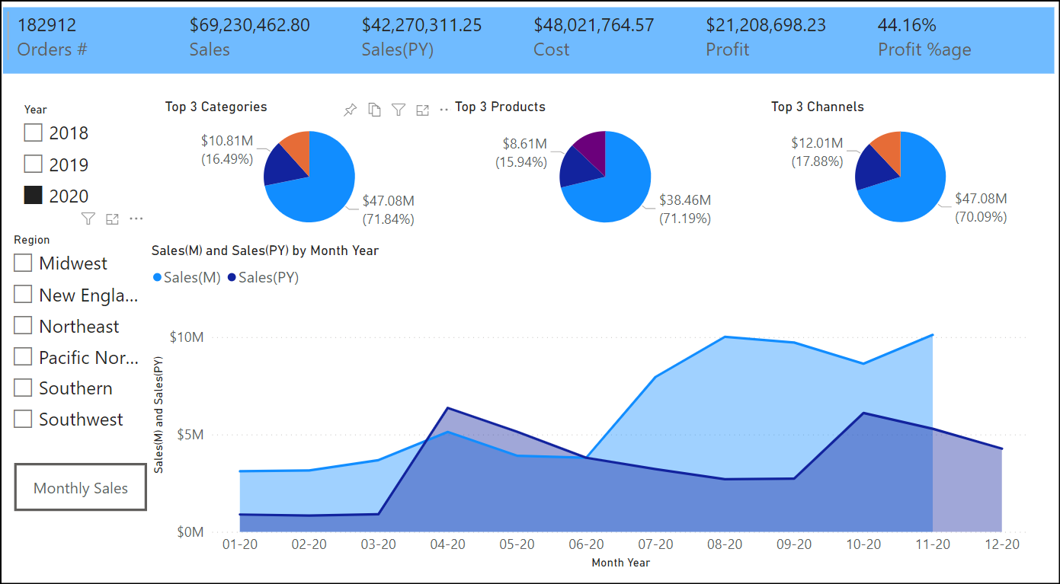
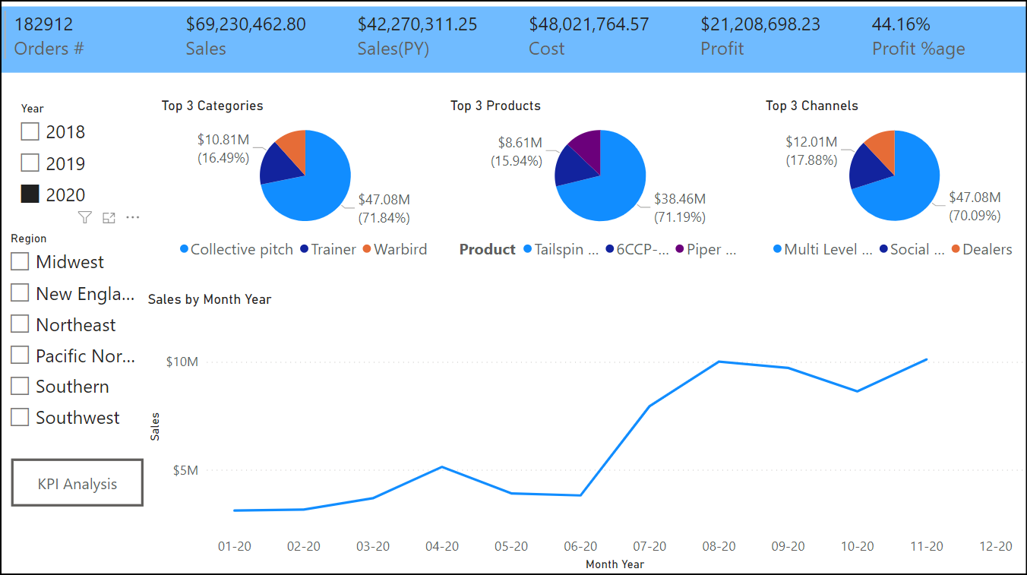
Bookmark
A bookmark captures the state of a report page. This includes the settings you've made to filters, slicers, and visuals on that page.

Slide 19
Knowledge Check
Q01 – Which filter is not available in Power BI reports?
A. Page Level B. Report Level C. Visualization D. Page Type
A01 - A
Q02 – Can you use bookmarks to create a slide show in Power BI?
Yes
No
Varies based on type of visuals
A02 – A, Yes you can.

Slide 20
Lab 07: Design Report in Power BI Desktop Enhanced
In this lab you learn how to:
Sync slicers
Create a drillthrough page
Apply conditional formatting
Create and use bookmarks

